Slide 1

SAP Business Network

Slide 2

Waar gaan we het over hebben?
What is the SAP Business Network?
'Standard' and 'Enterprise' Account
Why do we use the SAP Business Network?
What do we do currently? (Gasunie)
What is the desired situation?
What are the benefits of going along with the onboarding?
What do you have to do to use the SBN?
Does the use of SAP include a fee?
Questions?

Slide 3
What is the SAP Business Network?
The SAP business Network is a free software that is widely used for logistics. (Originally a German company)
It is an easy tool to make trades and ensure high quality
You log in online via service.ariba.com and you can use manual or automatic invoicing (EDI)
You can put important business processes in 1 portal and use dashboards
It is used worldwide, with about 2 million active users*
Bron: SAP News Center – SAP Named a leader in IDC MarketScape

Slide 4

Standard Account
There are basically to use the SAP Business Network. This is the case with a Standard Ariba Network account. However, if the supplier is paid more than 250,000 EUR per year and exchanges more than 5 documents with us via SAP, SAP will propose to switch to an Enterprise Ariba account. (The suppliers will then receive an email or notification, but conversion is not mandatory)

Slide 5

Enterprise Account
For Enterprise, rates only apply if you exchange more than a certain volume of documents with all the vendors you do business with in the Enterprise account. From the date you convert your account to an Enterprise account and use the Enterprise benefits, costs will be incurred. However, the invoice for this will only come after 1 year after you convert the account to Enterprise. Even if you accidentally turn it on! The SAP calculator can give an average of the costs of an Enterprise account.
Notes:
Heeft men vragen over de kosten, of zijn ze het er niet mee eens. Dan kunnen ze contact opnemen met SAP via het vraagteken icoontje naast de initialen rechtsboven als je ingelogd bent in service.ariba.com

Slide 6
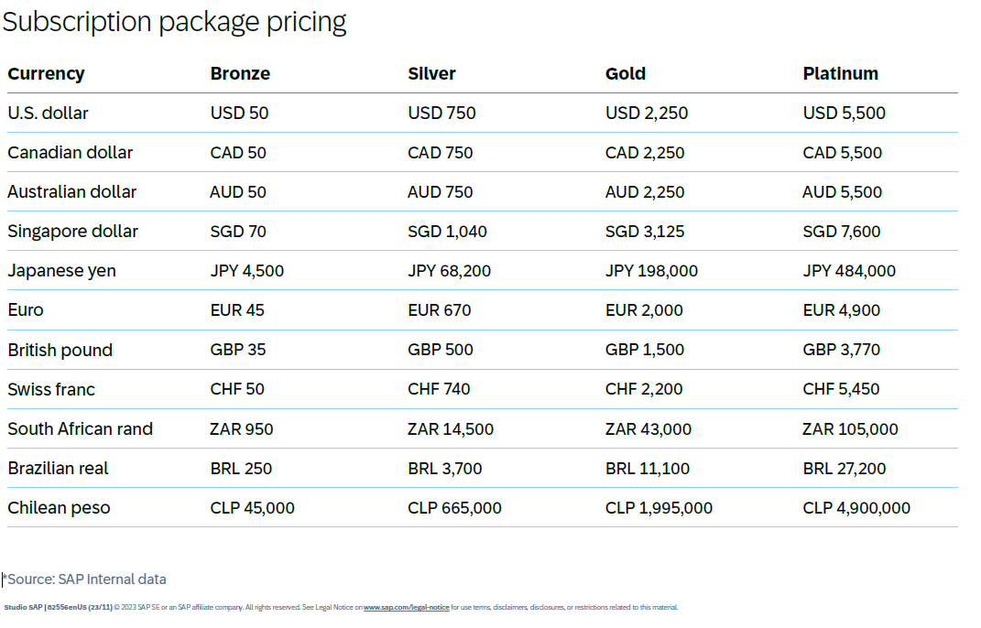
Enterprise Plans
When converting, you always start at
Bronze. You can convert this manually
To silver, gold or platinum.
But SAP will also indicate in good time
When you, as a supplier, have a
Should go on the next
"Tier".

Slide 7
Why do we use the SAP Business Network?
Gasunie has been using SAP since around 2005 and is growing along with the SAP updates and the global market.
Because Gasunie is an energy transport company, many logistics processes are involved, SAP is the ideal software to handle these logistics processes in 1 portal
Payments and workflows are automated as much as possible
Efficient deliveries, as soon as a material is delivered to the Gasunie central warehouse in Deventer, it is entered into the SAP system. This way, everyone within Gasunie with the authority knows that a material has been received.
A great way to manage all processes from Sourcing to ordering to payment process. But we also handle systems such as the well-known CLIK notification at Gasunie in SAP.

Slide 8

Collaborating with Gasunie

Slide 9
What do we do currently?
At the moment, the Purchase Orders are largely sent by e-mail in a PDF and invoices are handled manually
Because Gasunie is growing and also working with more suppliers, this results in a high flow of manual operations
Manual operations are prone to possible errors and involve a long processing time
The process of confirming a Purchase Order, checking again after delivery whether the invoice contains the correct amounts is long and can result in late payments (e.g. removing unnecessary freight costs from the invoice is extra work)
Gasunie wants to prevent the current working method from having an impact on payment terms and take preventive action

Slide 10

What is the desired situation?
The best thing is to receive all Purchase Orders in the SBN account. (SAP Business Network) Then you don't have to go to your e-mail manually, but you can find everything in 1 portal and invoice immediately.
Reduce the high flow of manual operations
Reduce possible longer processing times in the order to checkout process
That you, as a supplier, can see exactly when a Purchase Order has been confirmed by Gasunie and then invoice online by entering your own invoice. You can automate this process together with Gasunie specialists.
Collaborate efficiently through the SAP Business Network and reduce as many delays as possible from ordering to payment process and other logistics processes
All suppliers with which Gasunie does business invoice via the SBN

Slide 11
What are the benefits of going along with the onboarding?
With the use of the SBN, you create real-time visibility, the possibility to use one dashboard and easy and efficient invoicing.
You can immediately detect disruptions
Easy invoicing as soon as the purchase order is available
You can analyze and archive your data (Enterprise feature)
Automate your transactions with, for example, system integration (Enterprise function)

Slide 12

Onboarding

Slide 13
What do I have to do to use the SBN?
STEP 1: As a supplier, you will receive an invitation from Gasunie to use the SAP Business Network
The email address you provide is an email address on which you create a free account in advance. You also provide this address to receive the online invitation from Gasunie.
STEP 2: As a supplier, you then fill in the mandatory fields in the so-called 'Supplier Profile Questionnaire' in order to enter yourself correctly in the system as a creditor.
STEP 3: You fill in the required fields, where necessary, you must upload documents. You are then fully registered. Gasunie offers support from procurement to speed up this process, but first look at gasunie.nl/leveranciers
STEP 4: As soon as everything is completed, you will receive a request for activation from Gasunie. You accept this engagement in the portal and then you can start doing business with Gasunie online via service.ariba.com

Slide 14

Does the use of SAP include a fee?
There are no costs associated with using an SAP Business Network Account (SBN Account)
If you are above the amount of 250,000 EUR in transactions, SAP will ask if you want an Enterprise Account, this is optional
If you don't accept it, you can use the Standard account for free
If you do accept the upgrade of SAP, you will become an Enterprise account for free
Within the Enterprise account category, you may have costs if you have a lot of PO’s and invoices.
In conclusion.. Always use a Standard account for free use of the SBN
Tool to calculate how much Enterprise account would cost TOOL
Bron: SAP Business Network supplier account

Slide 15
User Guides
Registration and re-registration
Establish customer relationship
Submit invoice

